Slide 1
Hotel Reception Desk Automation
Presented by: Sanket Dhole

Slide 2
Problem Statement – Challenges Identified
Hotels require a centralized & efficient guest management system
Manual check-in/check-out causes delays and errors
Guest ID proofs need secure storage & audit tracking
Service teams (Room, Wi-Fi, Restaurant) lack automation
Frequent manual follow-ups reduce productivity

Slide 3
Proposed Solution – End-to-End Automation
Play Framework-based application for room booking & guest management
Database-backed storage for rooms, guests, bookings & ID proofs
Kafka event-driven messaging to automate notifications
Akka-based microservice for scalable asynchronous processing
Automated email system for Room Service, Wi-Fi credentials & Restaurant Menu

Slide 4
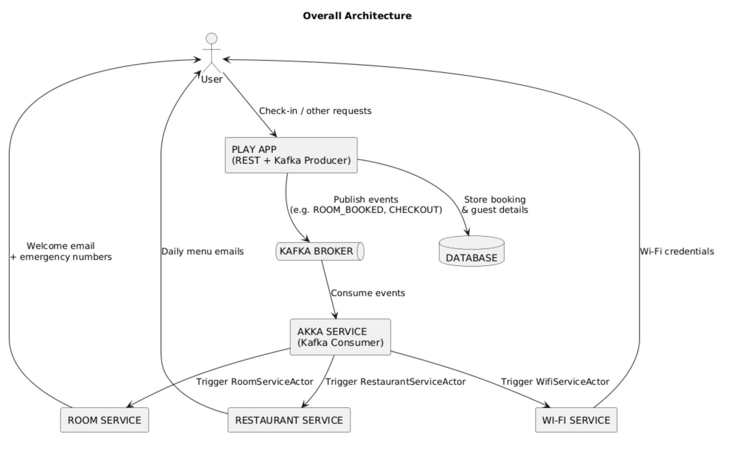
Overall Architecture

Slide 5
Detailed Workflow – Event Driven Flow
Guest checks in: Room selected + ID proof uploaded
Booking stored in database with timestamp
Kafka publishes event: ROOM_BOOKED
Akka Microservice consumes event and triggers respective actors
RoomServiceActor → Welcome email with emergency numbers
WifiServiceActor → Wi-Fi credentials
RestaurantServiceActor → Daily menu emails until checkout
Checkout event stops scheduled restaurant messages

Slide 6
ERD – Core Database Structure
ROOM: id, category_id, floor, room_number, status, category_name, price
GUEST: id, name, email, phone, id_proof_path
BOOKING: id, guest_id, room_id, check_in, checkout, status
NOTIFICATION_LOG: id, booking_id, service_type, timestamp, status

Slide 7
Deployment Plan (Improved Format)
Component | Deployment
Play Application | Docker Container
Kafka + Zookeeper | Docker Compose
Akka Microservice | Docker Container
Database (MySQL/Postgres) | Docker Container
SMTP Email Service | Gmail / SMTP Server

Slide 8
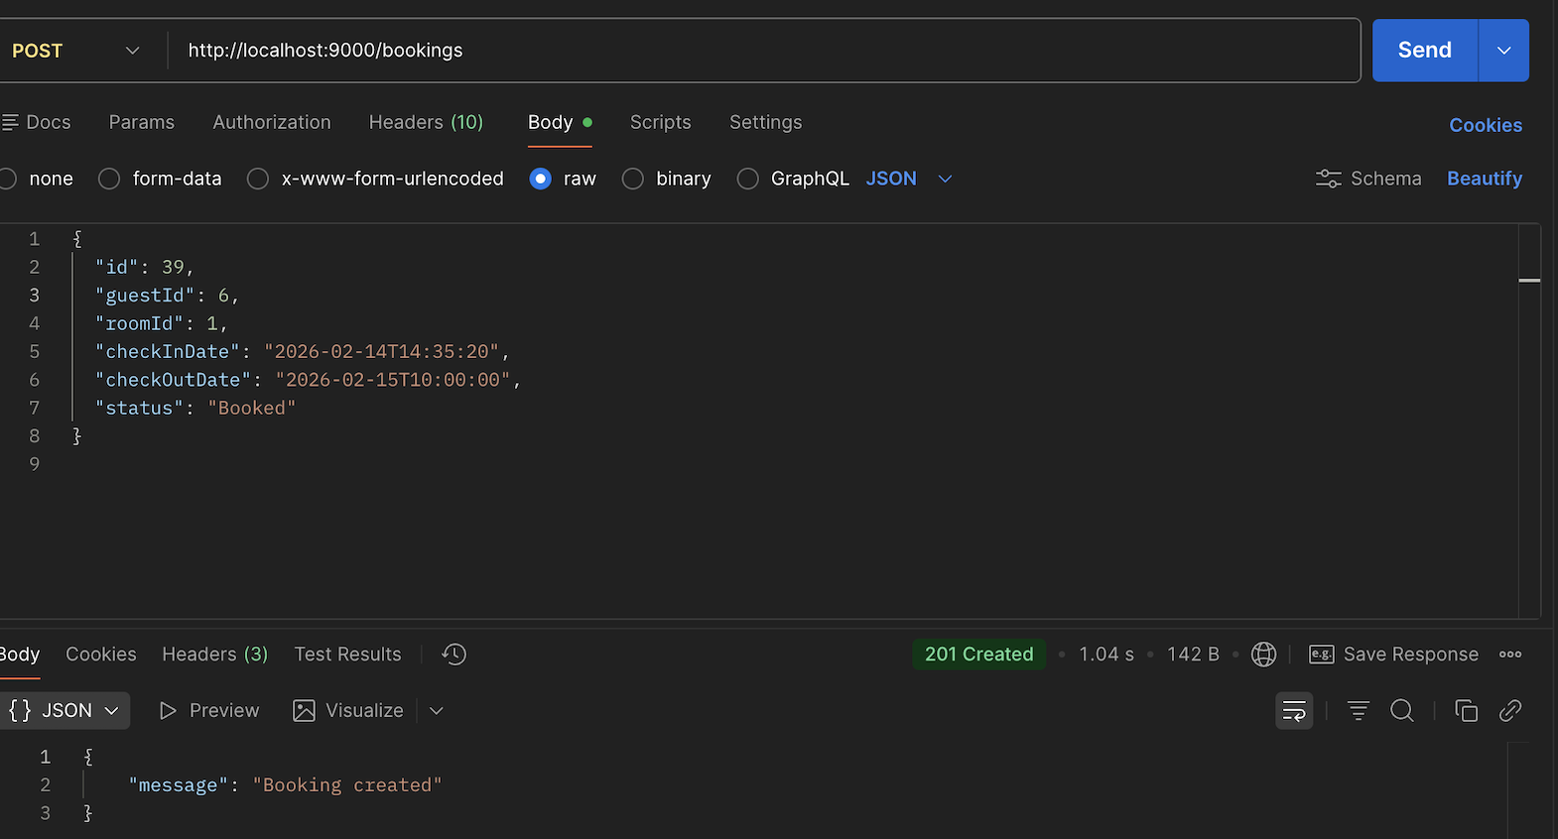
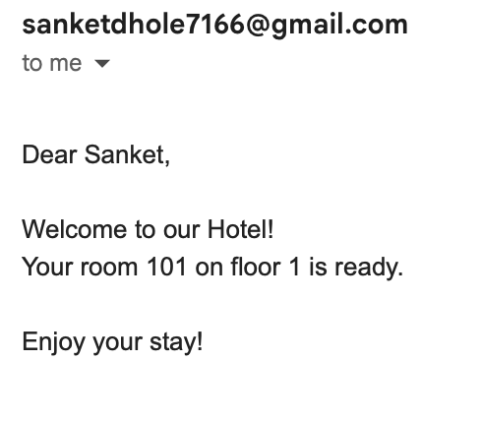
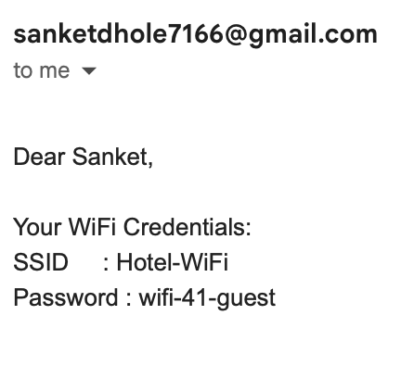
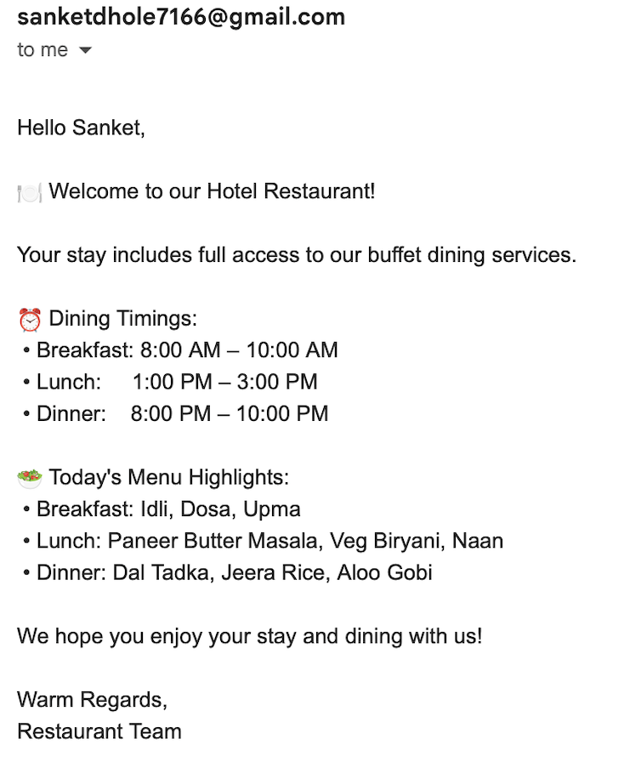
Booking Create

Slide 9
Features Implemented (Enhanced Table)
Feature | Technology
REST APIs | Play Framework
Database Access Layer | Slick
Event-driven Messaging | Apache Kafka
Microservice Development | Scala
Async Processing | Akka Actor Model
Email Integration | SMTP
Deployment | Docker

Slide 10
Conclusion – Key Takeaways
End‑to‑end automation improves guest onboarding efficiency
Minimizes manual coordination across service teams
Highly scalable architecture using Kafka + Akka
Reliable, asynchronous communication between microservices
Foundation ready for full hotel digital transformation

Slide 11
Thank You
Questions?
Contact: Sanket Dhole

